Slide 1

Women's Empowerment
Empowerment of women is a multifaceted concept that involves enhancing their ability to make strategic life choices and take control over their personal destinies. It encompasses a broad range of areas including education, economic participation, and decision-making power.

Slide 2
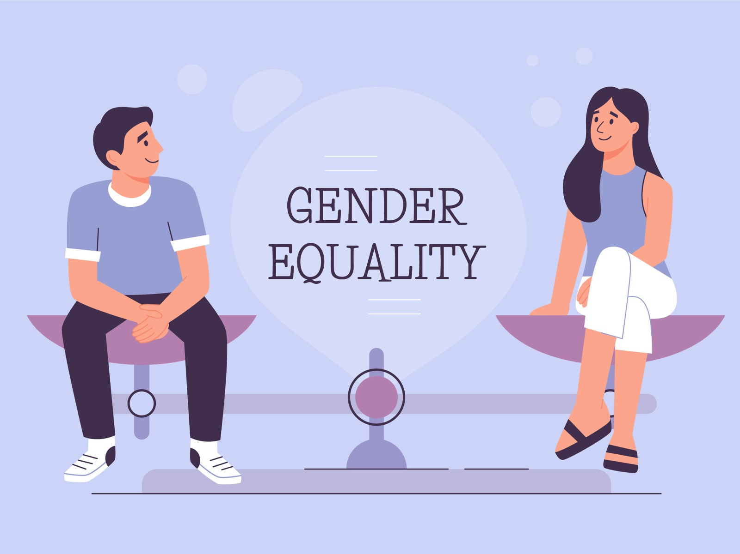
Gender Equality
Gender equality refers to the equal rights, responsibilities, and opportunities of all individuals, regardless of their gender. It involves creating an environment where both men and women can have access to the same resources and opportunities and be able to contribute and participate in society equally.
1
Equal Opportunities
2
Eliminating Discrimination
Ensuring fair and unbiased opportunities for men and women in education and employment.
Ending discrimination against women in public and private life.
3
Equal Pay
Ensuring that women receive the same pay as men for work of equal value.

Slide 3


Women's Rights
Women's rights are the fundamental human rights that should be guaranteed to all women and girls. These rights include the right to live free from violence, slavery, and discrimination; to be educated; to own property; to vote; and to earn a fair and equal wage.
Human Rights
Education
Protection against gender-based abuses and violence.
Equal access to education and learning opportunities.

Slide 4
Women in Leadership
Women in leadership roles play a crucial part in shaping the future and influencing societal norms. It involves promoting female leadership positions in political, economic, and social spheres, thereby ensuring diverse and inclusive decision-making processes and policies.
1
Breaking Barriers
Overcoming societal and systemic barriers to access leadership positions.
2
Inspiring Others
Mentoring and supporting the next generation of female leaders.
3
Driving Change
Advocating for policies that promote gender equality and diversity.

Slide 5
Women in the Workforce
Women's participation in the labor force is a critical aspect of a country's economic growth and development. It involves ensuring that women have equal opportunities, equal pay, and the ability to pursue their careers and achieve financial independence.
Equal Opportunities
Work-Life Balance
Leadership Positions
Eliminating gender-based barriers in career advancement.
Creating supportive work environments for working mothers and caregivers.
Increasing the representation of women in leadership roles and boardrooms.

Slide 6
Women's Health
Women's health refers to the physical, mental, and social well-being of women. It encompasses a broad range of issues, from reproductive health to noncommunicable diseases, and should be a priority area for healthcare policies and programs.
Reproductive Rights
Mental Well-Being
Preventive Care
Access to reproductive healthcare and family planning services.
Promoting mental health awareness and support for women.
Ensuring access to regular screenings and preventive healthcare services.

Slide 7
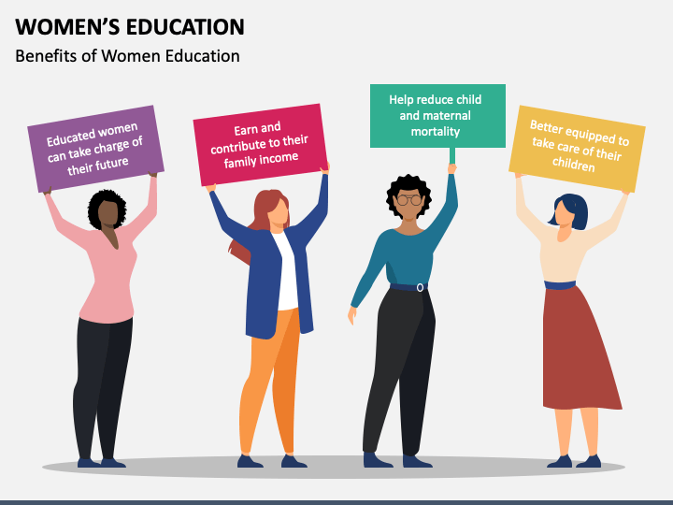



Women's Education
Education is a powerful tool for empowering women and girls to reach their full potential. It involves ensuring access to quality education, eliminating gender disparities in education, and providing lifelong learning opportunities for women at all stages of life.
Access to Education
Removing barriers to access and completion of education for women.
Skills Development
Equipping women with the skills and knowledge for future success.
Continuing Education
Promoting lifelong learning and educational opportunities for women.

Slide 8
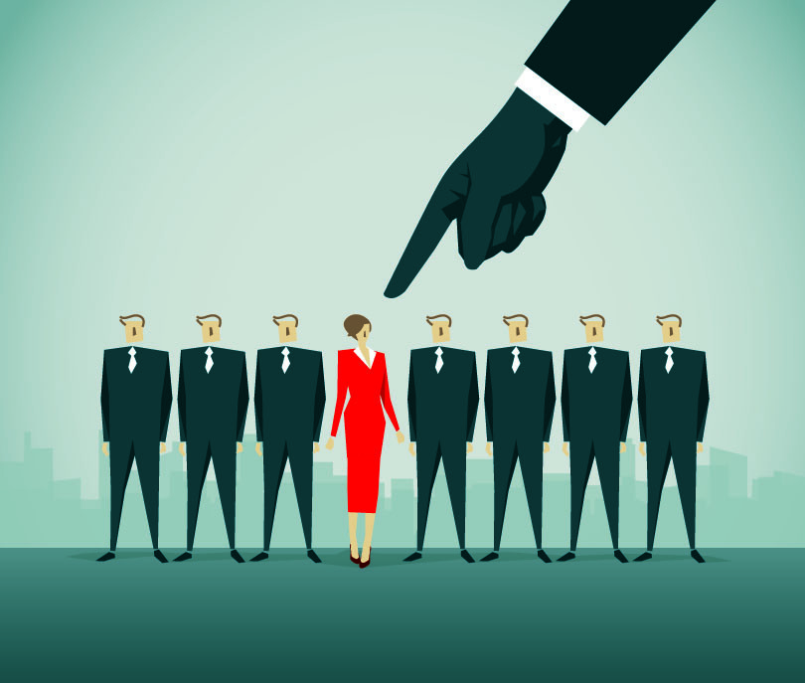
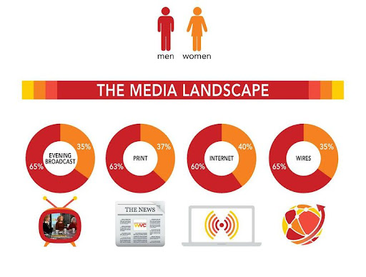
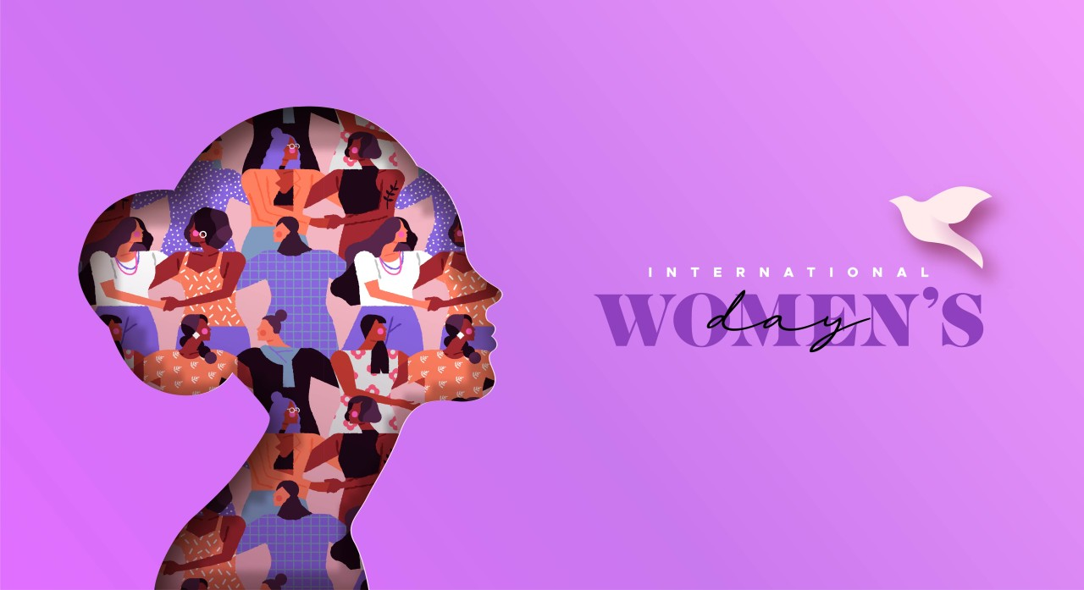
Women's Representation in Media
Women's representation in media is crucial for shaping perceptions and attitudes towards gender roles and women's capabilities. It involves promoting accurate and diverse portrayals of women and their achievements in media, advertising, and entertainment.
Diverse Portrayals
Gender Equality Advocacy
Positive Role Models
Representing women of different backgrounds, abilities, and experiences.
Promoting gender equality and challenging stereotypes through media platforms.
Highlighting inspiring female role models across various media channels.

